Slide 1

Exploring Kappaphycus alvarezii (Tambalang) and Eucheuma denticulatum (Guso) Properties as Sources for Bioplastic Production: Economical and Environmental Benefits for the People of BARMM
Arcemo, Micaella M.
Quimio, Ma. Christine Angela S.
Robles, Ronnel Matthew N.
Tolentino, Nicole Dane R.
Lyceum of the Philippines University- Laguna

Slide 2
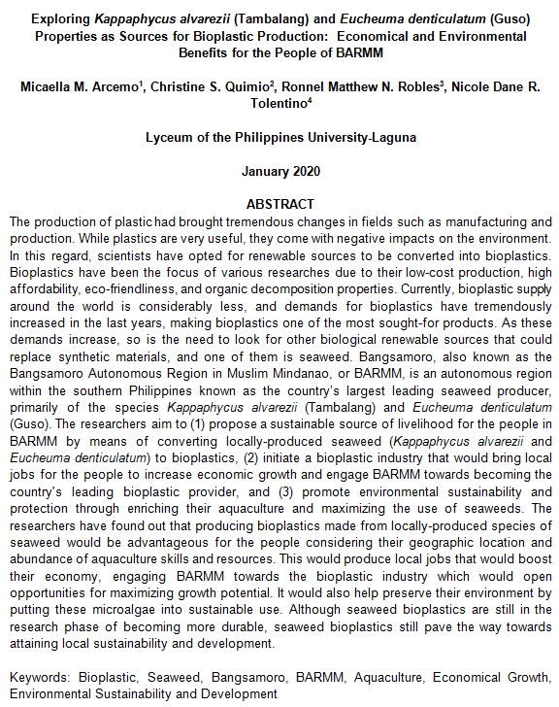

Slide 3
Introduction
Plastic as a “staple” in everyday lives
Plastics and their negative impact on the environment
8 million pieces of plastic pollution in the oceans
Philippines as the third biggest ocean polluter of plastic in the entire world
Sustainable alternatives for synthetic materials used in plastic production
Seaweed as a bioplastic material
Abundance of seaweeds in BARMM
Bangsamoro Organic Law or BOL (Republic Act No. 11054)
Basilan, Lanao del Sur, Maguindanao, Sulu, and Tawi-Tawi
Issues on poverty and stunted economic growth

Slide 4
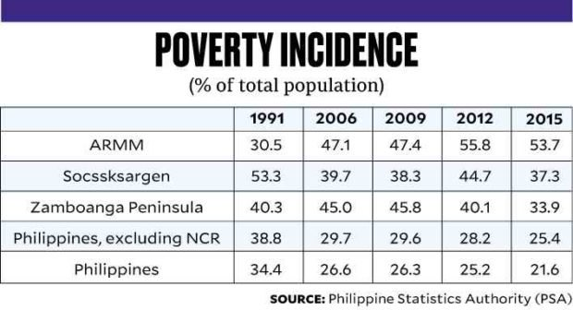
DATA
Table 1. Poverty Incidence in ARMM

Slide 5
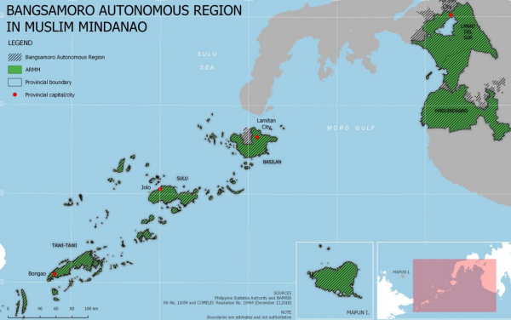
Figure 1. Geographical Map of BARMM

Slide 6
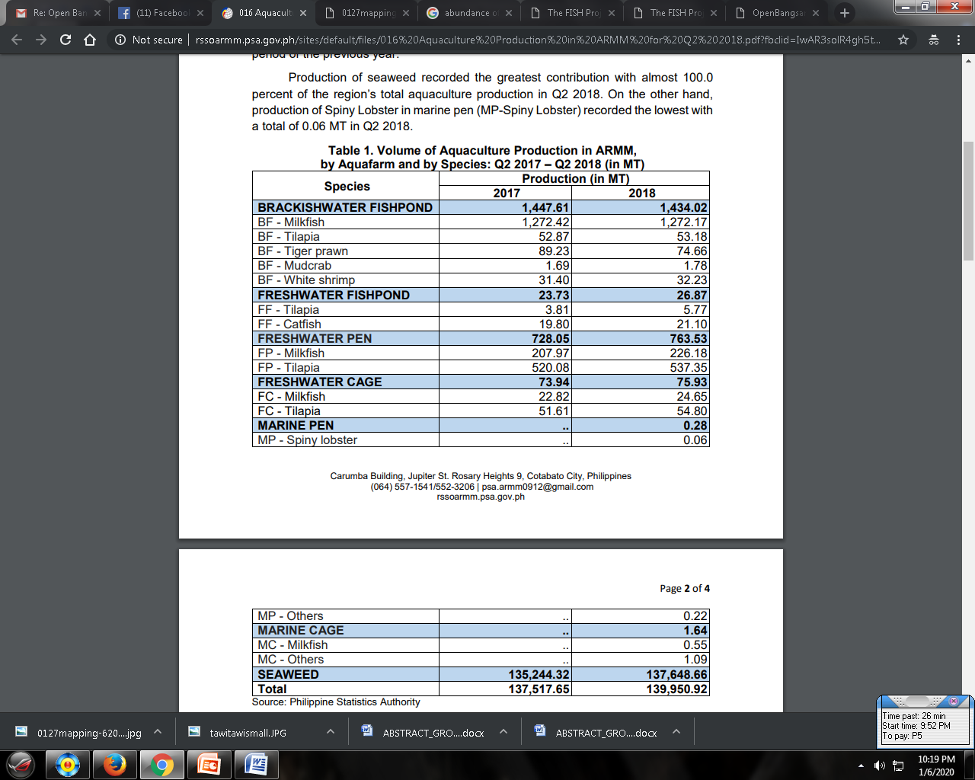
Table 2. Volume of Aquaculture Production in ARMM, by Aquafarm and by Species: Q2 2017 – Q2 2018 (in MT)

Slide 7
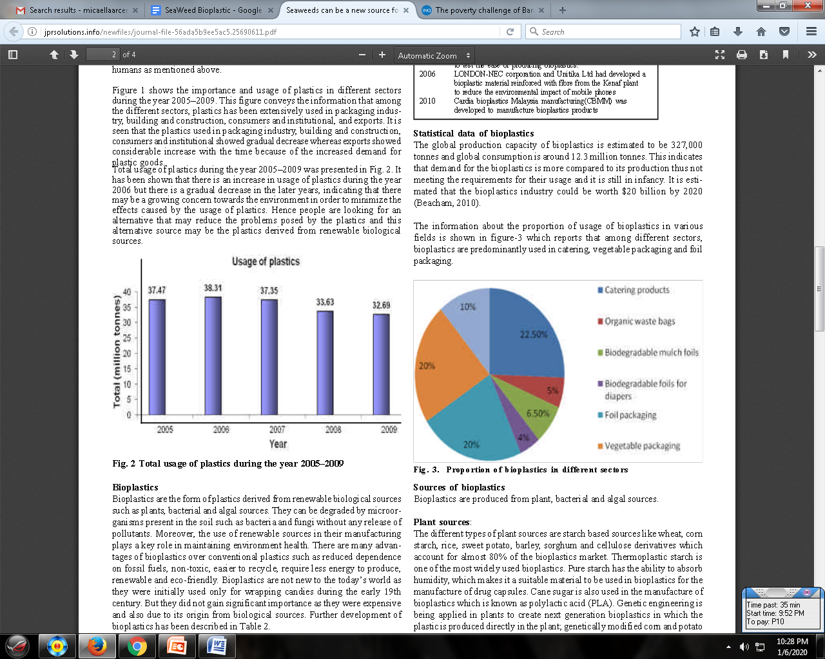
Fig. 2. Proportion of Bioplastics in Different Sectors

Slide 8
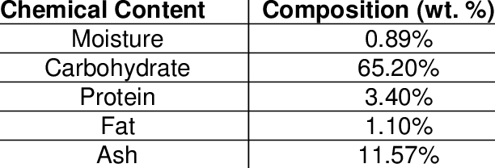
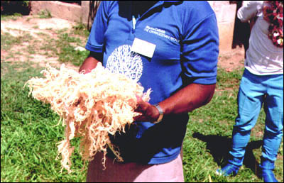
Table 4. Chemical Composition of Kappaphycus alvarezii (Tambalang)
Figure 3. Dried Kappaphycus alvarezii (Tambalang)

Slide 9
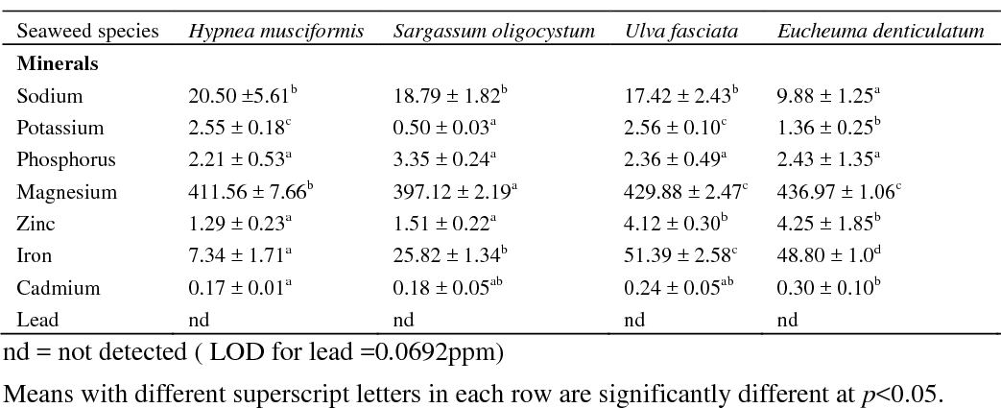
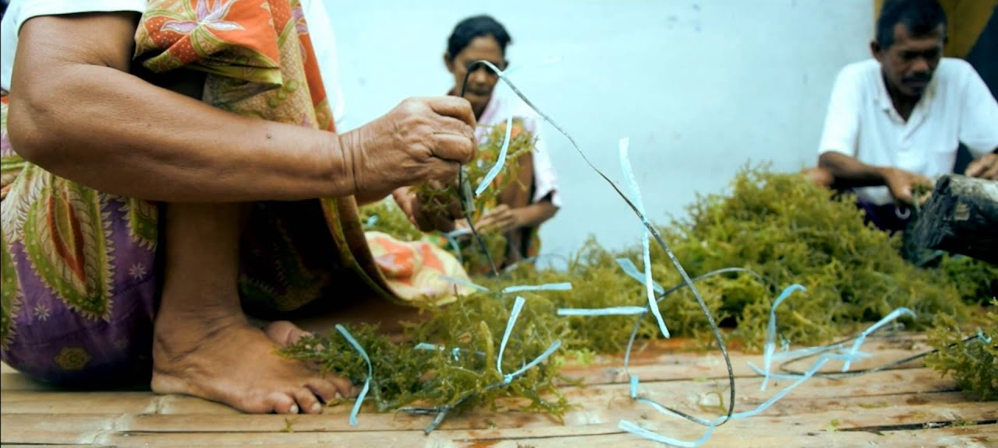
Table 4. Chemical Composition of Eucheuma denticulatum (Guso)
Figure 4. Harvesting Eucheuma denticulatum (Guso) in Mindanao

Slide 10
Objectives
To propose a sustainable source of livelihood for the people in BARMM by means of converting locally-produced seaweed (Kappaphycus alvarezii and Eucheuma denticulatum) to bioplastics
To initiate a bioplastic industry that would bring local jobs for the people to increase economic growth and engage BARMM towards becoming the country's leading bioplastic provider
To promote environmental sustainability and protection through enriching their aquaculture and maximizing the use of seaweeds

Slide 11
Methods
This study used a descriptive method of research.
In order to understand the people, the researchers immersed themselves into an observational approach by joining a group on social media where people from BARMM are members.
The researchers used a secondary data analysis or archival study approach in order to explore the properties of Kappaphycus alvarezii and Eucheuma denticulatum as potential bioplastic materials.
Data about the Bangsamoro were gathered through the Open Bangsamoro Data files as well as data from the Philippine Statistics Authority. The researchers also made use of videos, articles, and the latest news on BARMM.

Slide 12
DISCUSSION:
ADVANTAGES AND DISADVANTAGES
ADVANTAGES
Less dependent on fossil fuels
Use less energy for production
Recyclable,
Dissolves in water
Balance to mariculture
DISADVANTAGES
Still in the research phase
Durability
May cause pollution on seaweed nurseries or the production areas of seaweeds if not well-maintained

Slide 13
DISCUSSION:
OPPORTUNITIES AND THREATS
OPPORTUNITIES
Local jobs for the people of BARMM
A potential emergence of bioplastic industry
May expand economic growth
Environmentally sustainable
May be further developed/enhanced
THREATS
Bioplastics made of other material (i.e., mango)
Technological concerns

Slide 14
REFERENCES
Dy, R. (2019). The Poverty Challenge of Bangsamoro. Inquirer.net. Retrieved on December 2019 from https://business.inquirer.net/264224/the-poverty-challenge-of-bangsamoro
Jambeck, J. Geyer, R. Wilcox, C. (2015). Plastic Waste Inputs from Land into the Ocean. Science, 347(6223), 768-771. DOI: 10.1126/science.1260352
Gironi, F. & Piemonte, V. (2011). Bioplastics and Petroleum-based Plastics: Strengths and Weaknesses. Energy Sources Part A: Recovery (21):1949-1959. DOI:10.1080/15567030903436830
Global Biodegradable Plastics Market Report 2018-2025 - Market Size is Projected to Reach USD 6.73 Billion. (2018). GLOBE NEWSWIRE. Retireved on December 2019 from https://www.globenewswire.com/news-release/2018/11/05/1645081/0/en/Global-Biodegradable-Plastics-Market-Report-2018-2025-Market-Size-is-Projected-to-Reach-USD-6-73-Billion.html
Khalil, A., Tye, Y., Yap, S., et al. (2018). Effects of corn starch and Kappaphycus alvarezii seaweed blend concentration on the optical, mechanical, and water vapor barrier properties of composite films. Bioresources, 13(1):1157-1173. DOI: 10.15376/biores.13.1.1157-1173
Lagdameo, K., Espaltero, C., Ricarte, M., et al. (2015). The Effect of Glycerol to the Biodegradability and Flammability on Kappaphycus Alvarezii (Tambalang) Seaweed Bio-Plastic. Retrieved on December 2019 from http://www.spaconline.org/home/2015/08/04/the-effect-of-glycerol-to-the-biodegradability-and-flammability-onkappaphycus-alvarezii-tambalang-seaweed-bio-plastic/

Slide 15
REFERENCES
M.D. Guiry (2000 – 2020). The Seaweed Site: information on marine algae. Retrieved on December 2019 from http://www.seaweed.ie/algae/seaweeds.php
Plastics Exposed: How Waste Assessments and Brand Audits are Helping Philippine Cities Fight Plastic Pollution. (n.d.) Gaia. Retrieved on December 2019 from https://www.no-burn.org/waba2019/
Plastic Pollution – Facts and Figures. (2020). Surfers against Sewage. Retrieved on December 2019 from https://www.sas.org.uk/our-work/plastic-pollution/plastic-pollution-facts-figures/
Rajendran, N., Puppala, S., Raj S., et al. (2012). Seaweeds can be a New Source for Bioplastics. Journal of Pharmacy Research, 5(3),1476-1479.
Singh, S., Thakur, R., Singh, M., et al. (2015). ffect of fertilizer level and seaweed sap on productivity and profitability of rice (Oryza sativa). ResearchGate.Net. Retrieved on December 2019 from https://www.researchgate.net/publication/291284986_Effect_of_fertilizer_level_and_seaweed_sap_on_productivity_and_profitability_of_rice_Oryza_sativa
Seaweeds Used as a Source of Carrageenan. (n.d.) Retrieved on December 2019 from http://www.fao.org/3/y4765e/y4765e09.htm

Slide 16

Thank you!

